Slide 1
Beyond the Batter’s Box
Analyzing the Winners & Losers of America’s Pastime

Slide 2


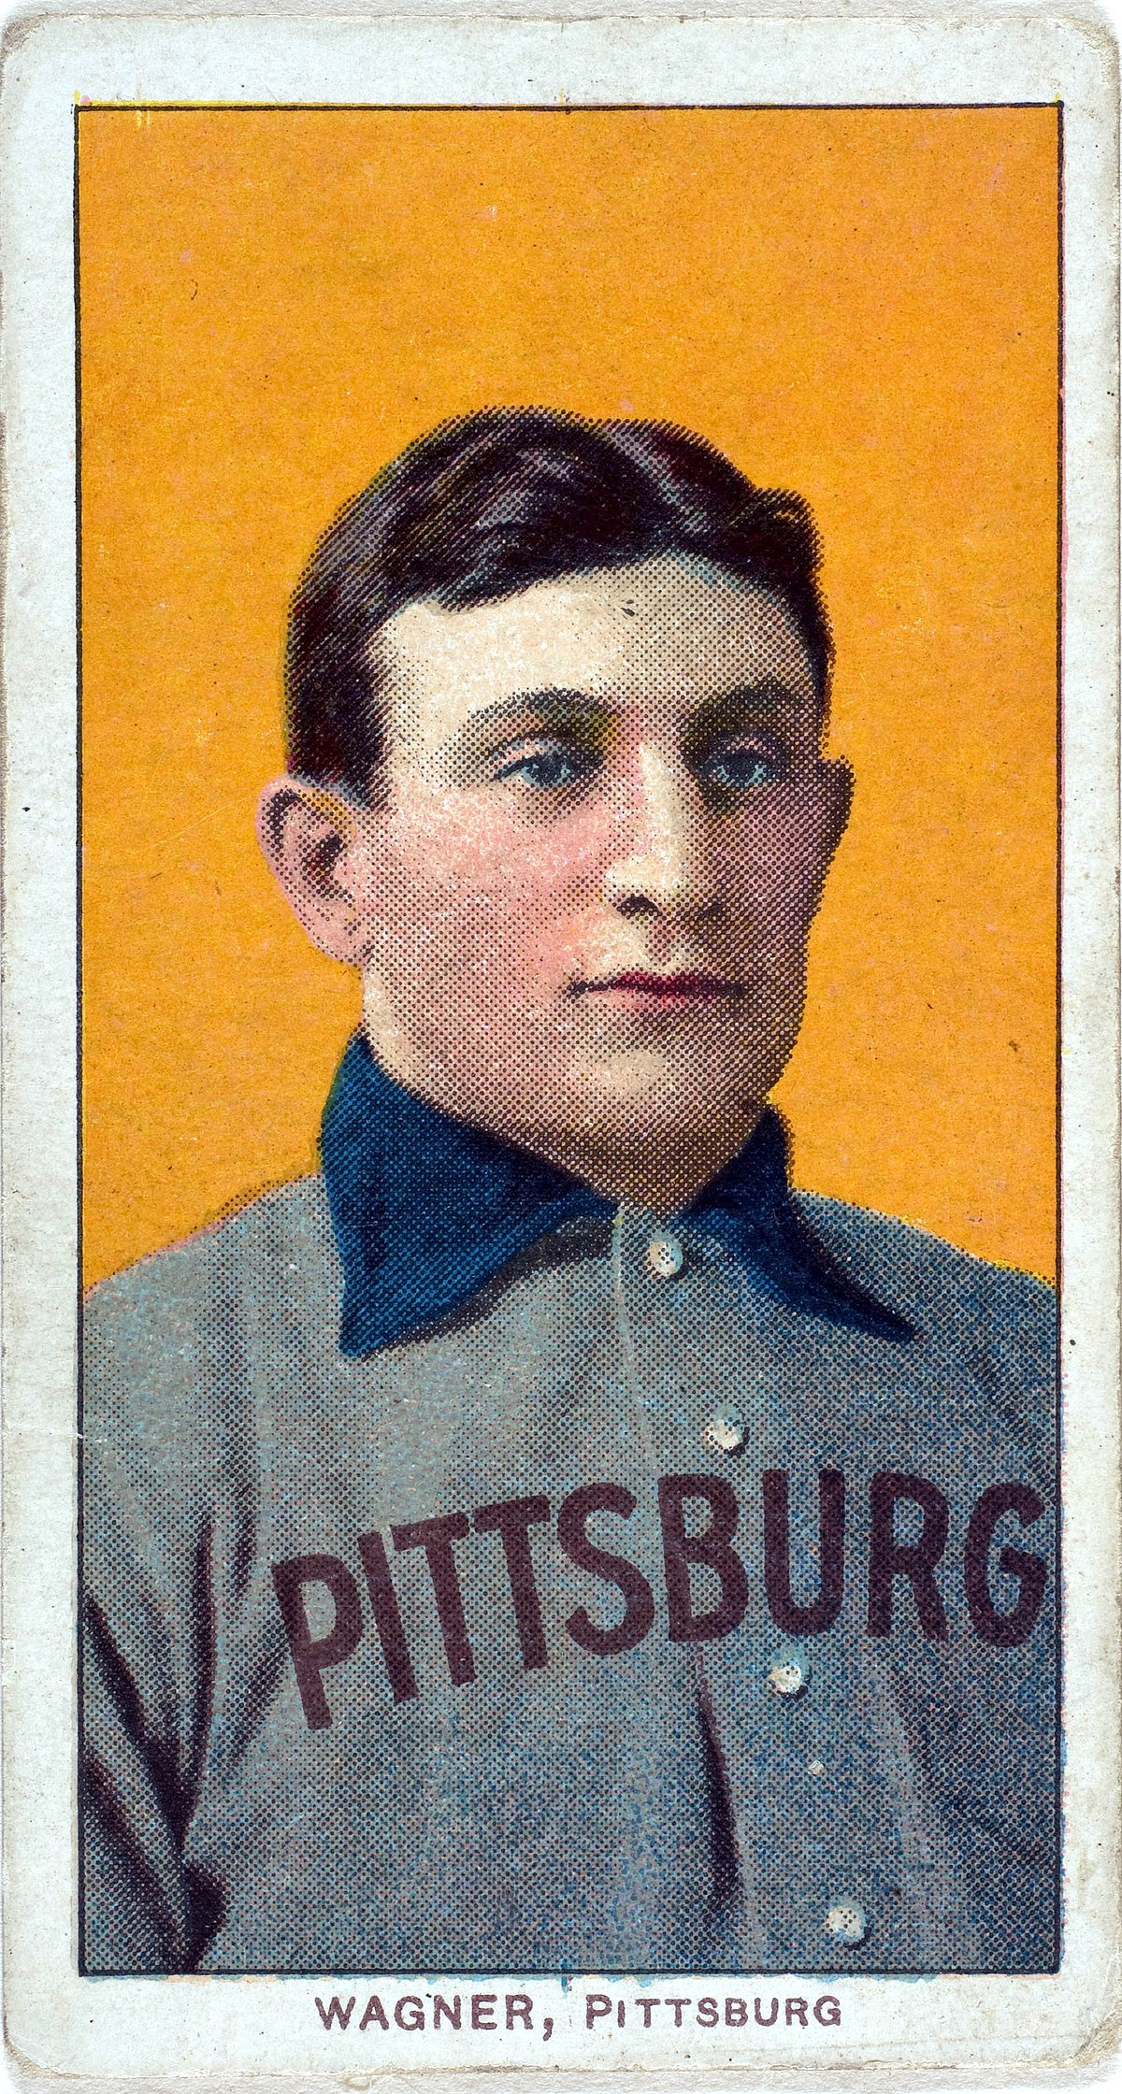
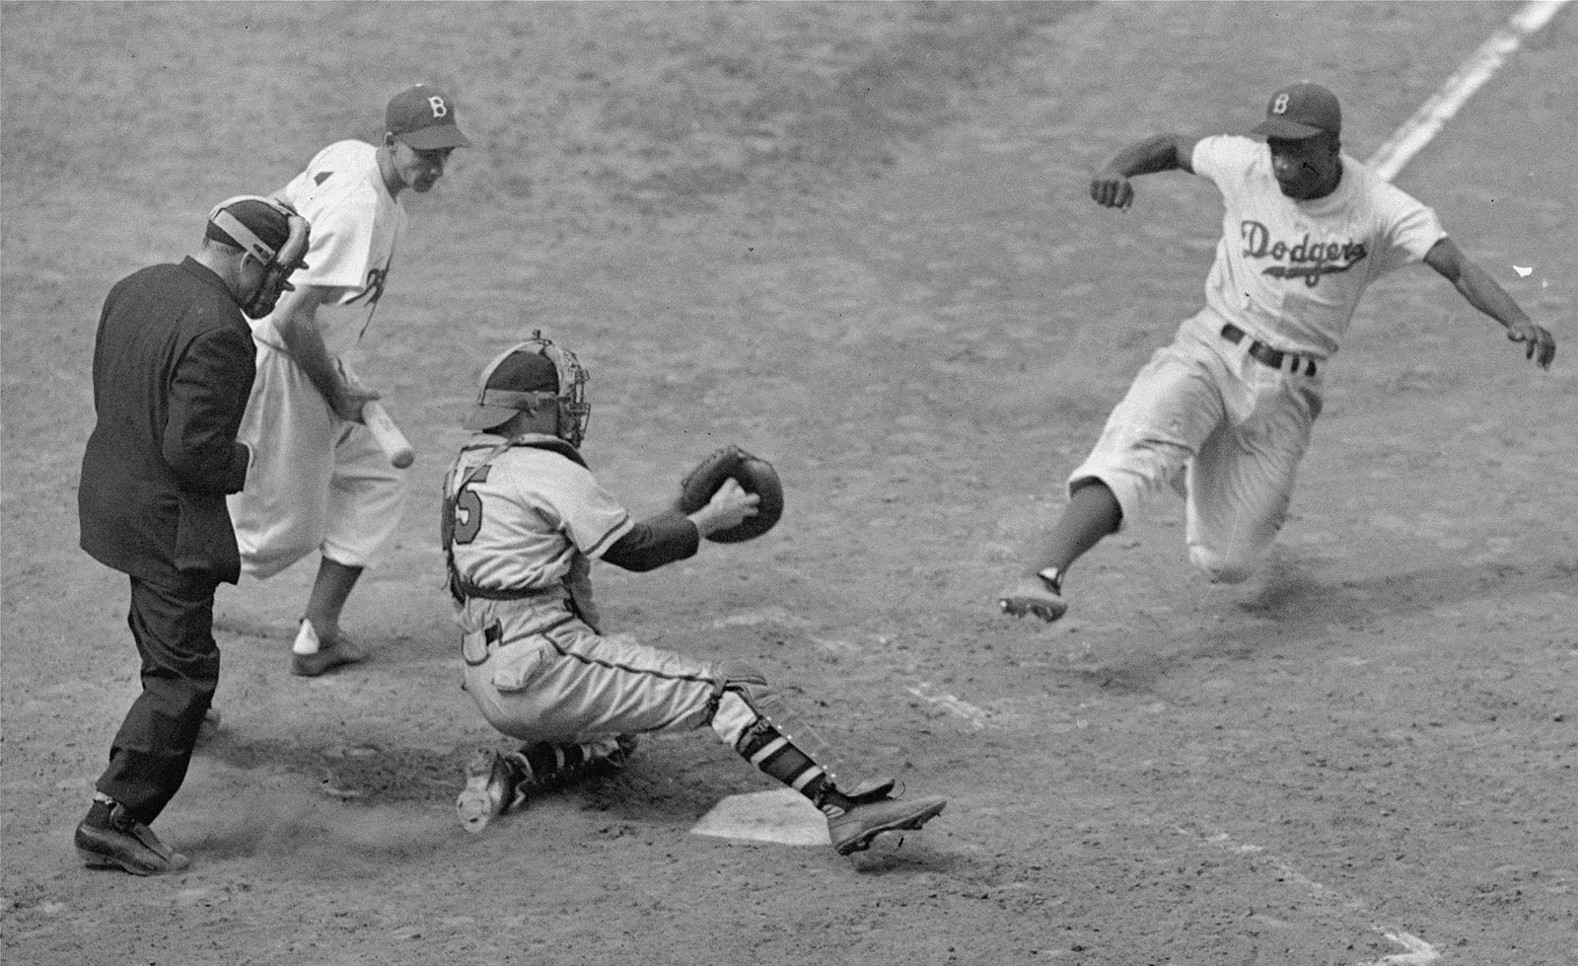
Why Baseball?
This topic was selected not just for our love of baseball, but because America’s Pastime has been around for over 120 years and has an immense volume of data available for a machine learning model to incorporate. Between fans of the game, historians, front-office types and gamblers, there will always be people interested in this data and the answers it holds.
David
Notes:
Some teams like the New York Yankees have a strong legacy of both spending money and winning championships. Other teams like the Tampa Bay Rays have had significant success (still chasing their championship), and have barely spent anything. We want to find out which strategy makes the most sense, and we’re going to use machine learning to do it.

Slide 3

Data Source
We’re leveraging an amazing open-source data center for Major League Baseball, the Lahman Database, which can be found here: http://www.seanlahman.com/baseball-archive/statistics/
For this project, we’re only using data from 1988-2016, due to the quickly increasing rate of pay for baseball players starting in the late 80’s.
Sean Lahman, Journalist, Author and creator of the Lahman Database
David
Notes:
Each zip file contains CSV documents that cover topics of interest in baseball. The data goes back all the way to 1871, so we can have confidence in the model’s depth of information.

Slide 4
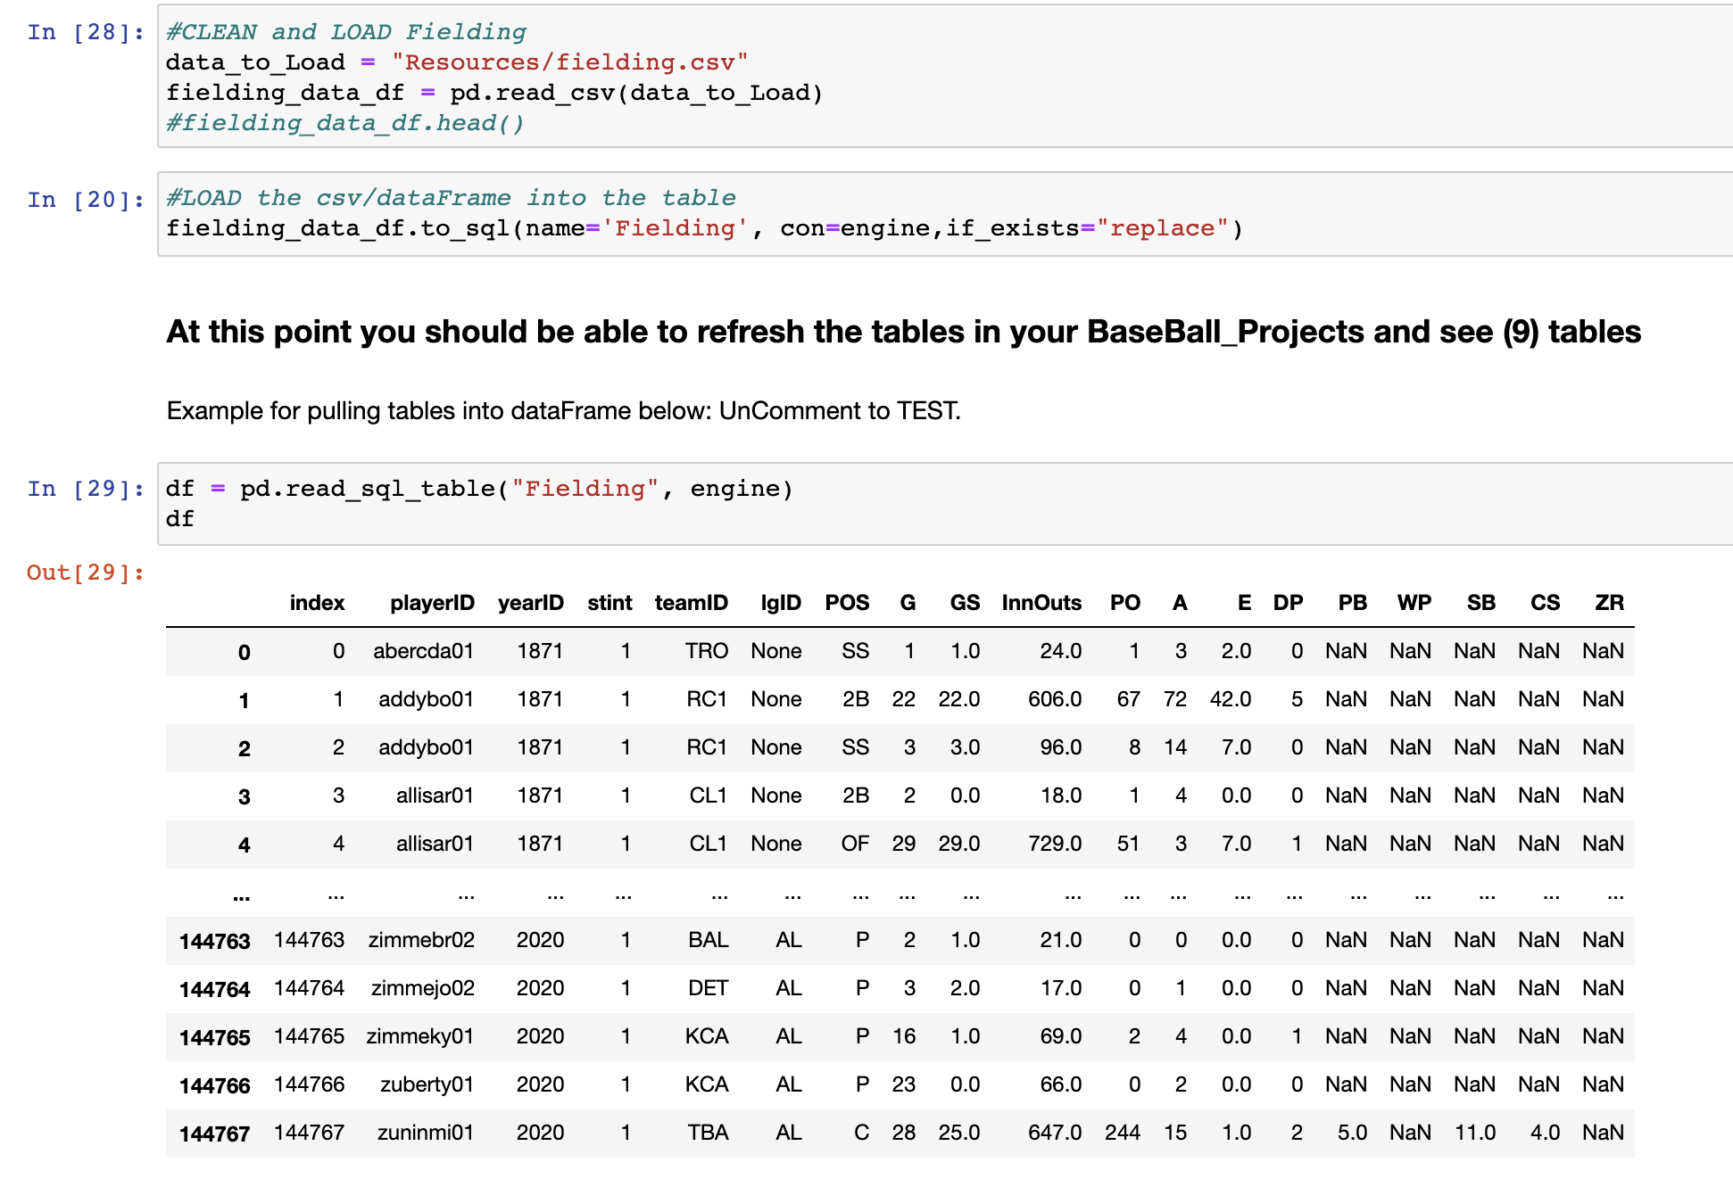
Database Integration
We decided to use Postgres for our data storage because of its ease of use and our familiarity with it. This created a challenge, however, since we would need some sort of subscription service like Amazon Web Services (AWS) to host our database and allow each team member access.
The solution? Creating duplicate databases on each of our local machines.
Austin
Notes:
The Steps below outline the how we were able to setup replica Postgres Databases on each team member’s device and make a connection, so our machine learning models were able to access the data.
1. Identify the csv files we would like to use for our analysis.
2. Import the relevant csv files into our notebook as a data frame using pandas so we could review the data.
3. Clean the data of irrelevant data columns that were of no use.
4. Create the connection to our Postgres database instance using sqlAlchemy so we can import the data into tables.
5. Import our partially cleaned data frames into our Postgres Database.
6. Confirm the data imported correctly by using the “pd.read_sql_table” pandas command. If the import was successful, this will display the designated table in our Jupyter notebook as a data frame.

Slide 5
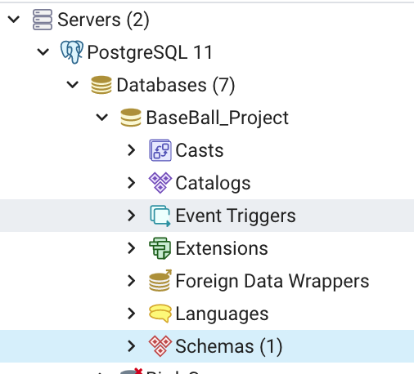
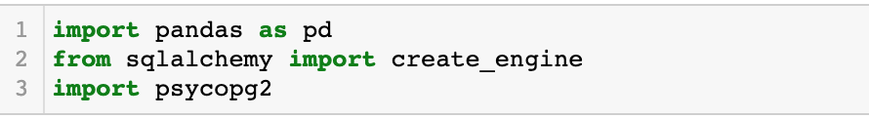
Database Integration
Tools We used :
PostgreSQL
PgAdmin
Jupyter Notebook
Pandas
SQLAlchemy
Austin
Notes:
The Steps below outline the how we were able to setup replica Postgres Databases on each team member’s device and make a connection, so our machine learning models were able to access the data.
1. Identify the csv files we would like to use for our analysis.
2. Import the relevant csv files into our notebook as a data frame using pandas so we could review the data.
3. Clean the data of irrelevant data columns that were of no use.
4. Create the connection to our Postgres database instance using sqlAlchemy so we can import the data into tables.
5. Import our partially cleaned data frames into our Postgres Database.
6. Confirm the data imported correctly by using the “pd.read_sql_table” pandas command. If the import was successful, this will display the designated table in our Jupyter notebook as a data frame.

Slide 6
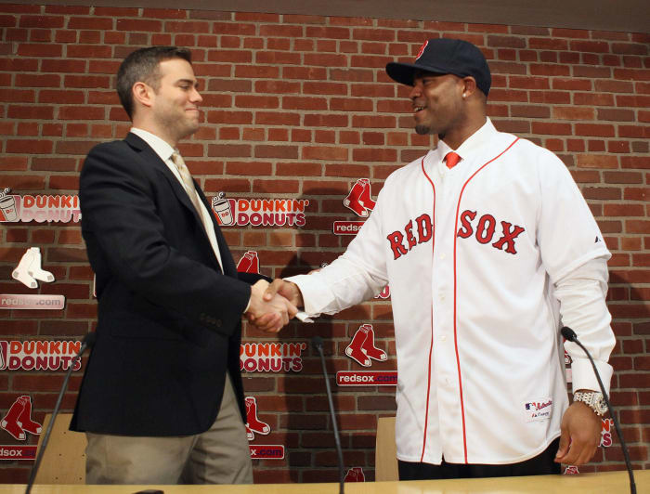
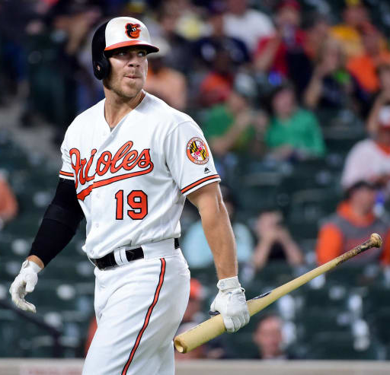
Asking Questions
We’ve incorporated our data – now what do we want to do with it?
Money talks. Baseball teams aren’t just about winning championships anymore – it’s big business. If you’re the General Manager of a team, how do you know you’re spending your money on the right players?
Some players get handed huge contracts only to epically underproduce. Can this be avoided?
Even once you’ve identified the players you want, should you go wild and shatter the Salary Cap? Will breaking the piggy bank open get you more wins?
Left: Carl Crawford signs an ill-fated 7-year, $142 million dollar contract with Boston.
Right: Chris Davis was one of the worst hitters in the league after inking his $161 contract.
David

Slide 7
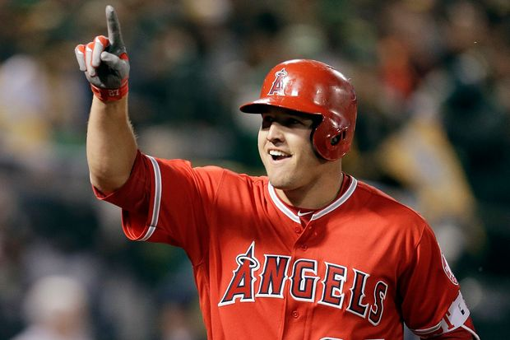
Rise of the Machines
Let’s use a Machine Learning Model to predict whether a player deserves to earn a premium salary.
We’re going to use Mike Trout’s personal statistics as our baseline for a ‘premium’ player. He’s arguably the best player in baseball today and has earned almost all his accomplishments while on a very team-favorable salary.
In addition to on-field stats, we’re going to factor in the awards each player won to see if they had any overall impact on their individual League.
Four-Time American League MVP Mike Trout
Christa
Notes:
The Random Forest Model uses classification to predict based on our salary target and our features which are year, team, stats (like strikeouts), and birth year. By pairing down the data, through combining and cleaning the csv files, it really dialed in to the details of what we wanted to measure.
Basing the main measures on Mike Trout's core statistics(SO,AB,R,H,HR,G,R and RBIs), we used his metrics as a baseline to look for when deciding our final goal. Also, including the ‘awardID’, which shows which award each player won, and ‘lgID’, which shows the league in to see if that had any impact.
Then the Random Forest Model interprets this information and gives an accuracy score based on what is the most impactful in deciding the salary of a player. The confusion matrix and list of importances each show the logic behind what determines how much to pay each player.
How does it work?
This model works by first understanding our decision tree. Through pre-processing the data, we chose supervised learning via a Random Foreast Model to get our desired answer of building a baseball team and what we should have as our base information when in choosing a player. The Random Forest Model uses classification to predict based on our salary target and our features which are year, team, stats (like strike outs), and birth year. By pairing down the data, through combining and cleaning the csv files, it really dialed in to the details of what we wanted to measure. Basing the main measures on Mike Trout's core statistics(SO,AB,R,H,HR,G,R and RBIs), I used his metrics as a baseline to look for when deciding our final goal. Also, including the awardID, which shows which award each player won, and lgID, which shows the league in to see if that had any impact. Then the random forest model interprets this information and gives an accuracy score based on what is the most impactful in deciding the salary of a player. The confusion matrix and list of importances each show the logic behind what determines how much to pay each player.
Why this specific model?
We wanted to use this supervised learning because we wanted to see the weighted importances that go into building a team based on salary. The salary was really the base in showing how much a player is worth based on factors like stats, year they were born, and year they played baseball.

Slide 8
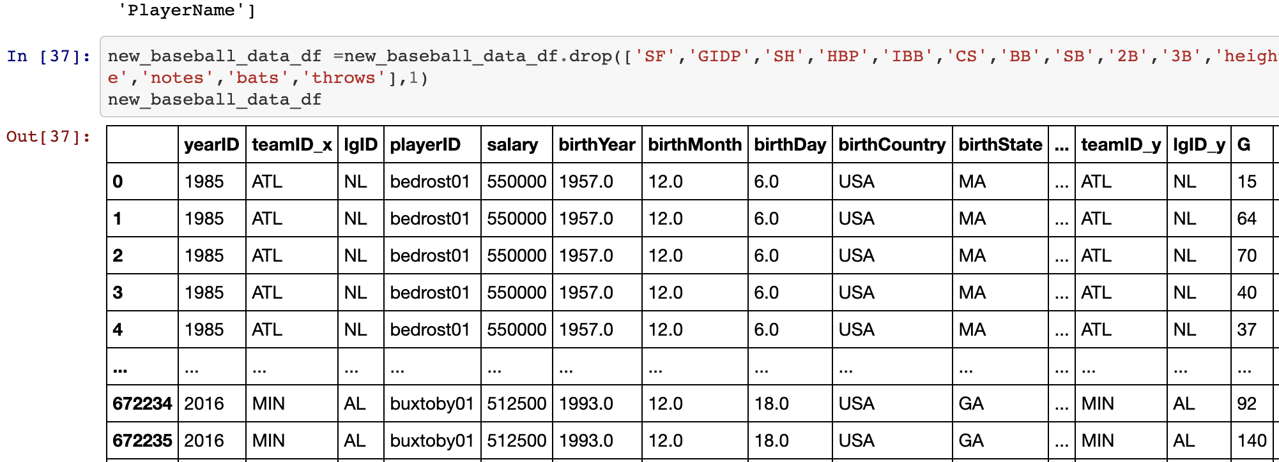
Rise of the Machines
Through pre-processing the data, we chose supervised learning via a Random Forest Model.
The Random Forest Model uses classification to predict based on our salary target and our features which are year, team, stats (like strikeouts), and birth year. By pairing down the data, through combining and cleaning the csv files, we can really dial in to the details of what we want to measure.
Christa
Notes:
The Random Forest Model uses classification to predict based on our salary target and our features which are year, team, stats (like strikeouts), and birth year. By pairing down the data, through combining and cleaning the csv files, it really dialed in to the details of what we wanted to measure.
Basing the main measures on Mike Trout's core statistics(SO,AB,R,H,HR,G,R and RBIs), we used his metrics as a baseline to look for when deciding our final goal. Also, including the ‘awardID’, which shows which award each player won, and ‘lgID’, which shows the league in to see if that had any impact.
Then the Random Forest Model interprets this information and gives an accuracy score based on what is the most impactful in deciding the salary of a player. The confusion matrix and list of importances each show the logic behind what determines how much to pay each player.
How does it work?
This model works by first understanding our decision tree. Through pre-processing the data, we chose supervised learning via a Random Foreast Model to get our desired answer of building a baseball team and what we should have as our base information when in choosing a player. The Random Forest Model uses classification to predict based on our salary target and our features which are year, team, stats (like strike outs), and birth year. By pairing down the data, through combining and cleaning the csv files, it really dialed in to the details of what we wanted to measure. Basing the main measures on Mike Trout's core statistics(SO,AB,R,H,HR,G,R and RBIs), I used his metrics as a baseline to look for when deciding our final goal. Also, including the awardID, which shows which award each player won, and lgID, which shows the league in to see if that had any impact. Then the random forest model interprets this information and gives an accuracy score based on what is the most impactful in deciding the salary of a player. The confusion matrix and list of importances each show the logic behind what determines how much to pay each player.
Why this specific model?
We wanted to use this supervised learning because we wanted to see the weighted importances that go into building a team based on salary. The salary was really the base in showing how much a player is worth based on factors like stats, year they were born, and year they played baseball.

Slide 9




Technology & Tools
Collaboration
Github
Github Desktop
Slack
Coding & Data Management
Jupyter Notebook
pgAdmin
Presentation
Tableau Public
Microsoft PowerPoint
Analysis Tools & Languages
Python Pandas
Matplotlib
Tableau
NumPy
SciPy
RandomForest
Christa

Slide 10
Answering Questions
As we begin to analyze our data, we will be using a combination of Machine Learning and Data Visualization to answer our key questions:
Does a higher team salary spend equate to more wins?
What statistics are the most significant in determining the salary of an individual player, based on historical data?
Can we build a model to predict whether or not a player will command a premium salary based on their demographics & statistics?
Christa

Slide 11
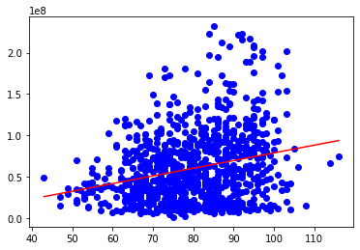
Answering Questions
Does Team Salary equal Team Success?
Let’s look at regular season wins from 1985 to 2016.
On this scatter plot, we can see a positive correlation between the money spent and the amount of wins a team gets.
However, it’s not a very strong correlation – the R value is only .25
The P-value is also extremely high – over 5.0 – meaning that the relationship doesn’t seem to have an impact on the result.
This could be due to various factors, including the ballooning of salaries in the 21st century. But one thing’s clear, your overall team expenditure doesn’t always equal success, especially in the regular season.
Frank

Slide 12
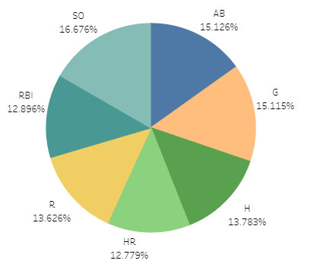
Answering Questions
Based on historical data, what statistic is the most important indicator of a player’s earnings?
The feature set we have chosen for this machine learning task includes:
SO: Strike-Outs
AB: At-Bats
G: Games Played
RBI: Runs Batted-In
R: Runs Scored
HR: Home Runs
H: Total Hits
Surprisingly, this model indicates that SO’s are the most significant indicator of salary – the only statistic in this set that would be deemed a ‘negative’ on a player’s performance.
Frank

Slide 13
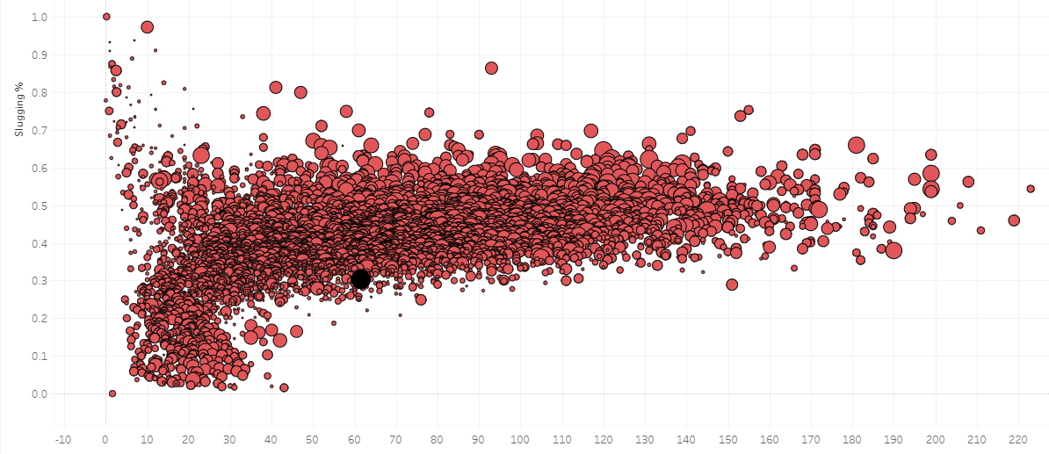
Answering Questions
Just because SO’s are the biggest indicator that predicts salary in our model, doesn’t mean that a player with the most SO’s should earn the highest pay.
Slugging Percentage (SLG) is the reflection of Strike-Outs in the game’s highest paid players.
Total Bases = (Singles) + (2 x Doubles) + (3 x Triples) + (4 x Home Runs)
In this scatterplot, we can see that the players on the right side – who have the most SO’s – have larger circles than the players on the left. This means they have larger salaries. This tracks with teams wanting to pay players with the most HR-potential large salaries.
SLG = Total Bases / At-Bats
Frank

Slide 14
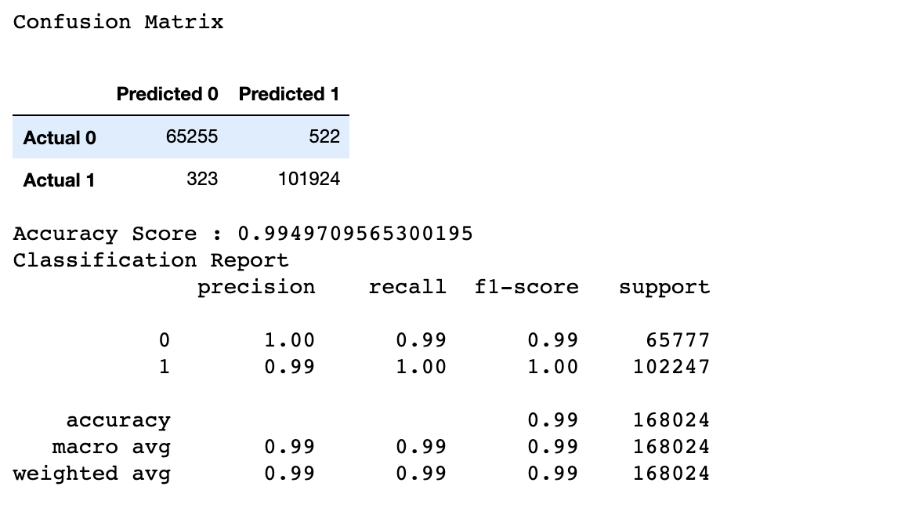
Answering Questions
Can we build a model to predict whether a player will command a premium salary based on their demographics & statistics?
In the confusion matrix below, we can see with 99% accuracy score, the model identified either a salary above $2M was a premium salary which were true negatives, or below $2M as true positives.
Christa
Notes:
Our original goal was to have a models accuracy at 80% or higher. We did accomplish that with 99% accuracy. There are some duplications just because there are some players who performed in multiple years, which can increase the accuracy of the data. Upon discussion, removing the multiple years and only have one year would not really give the data for anything other than salary because those individual stats and team stats.

Slide 15

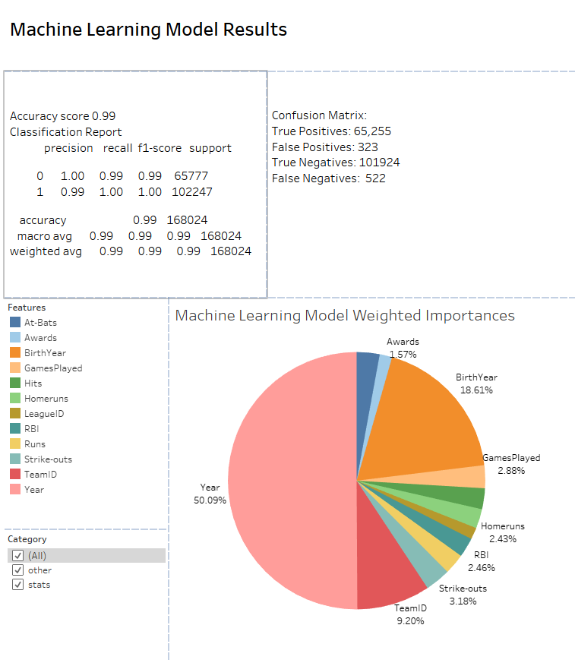
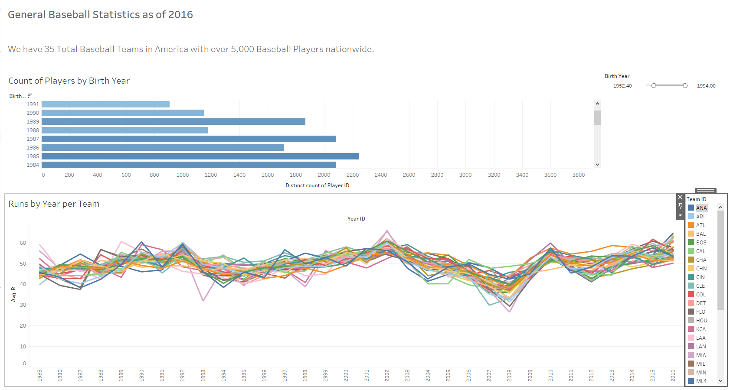
Dashboard
Five Dashboards hosted on Tableau
All integrative and interactive
Accessible through our Github
Frank
Notes:
We created Five Dashboards that were dedicated to general baseball statistics, salary relationship comparisons and the machine learning model results.
The goal of these dashboards was to have our data presented in an appealing way that is both integrative with our data and interactive so anyone can make their own observations of it
Each Dashboard has it’s own link accessible through our Github

Slide 16
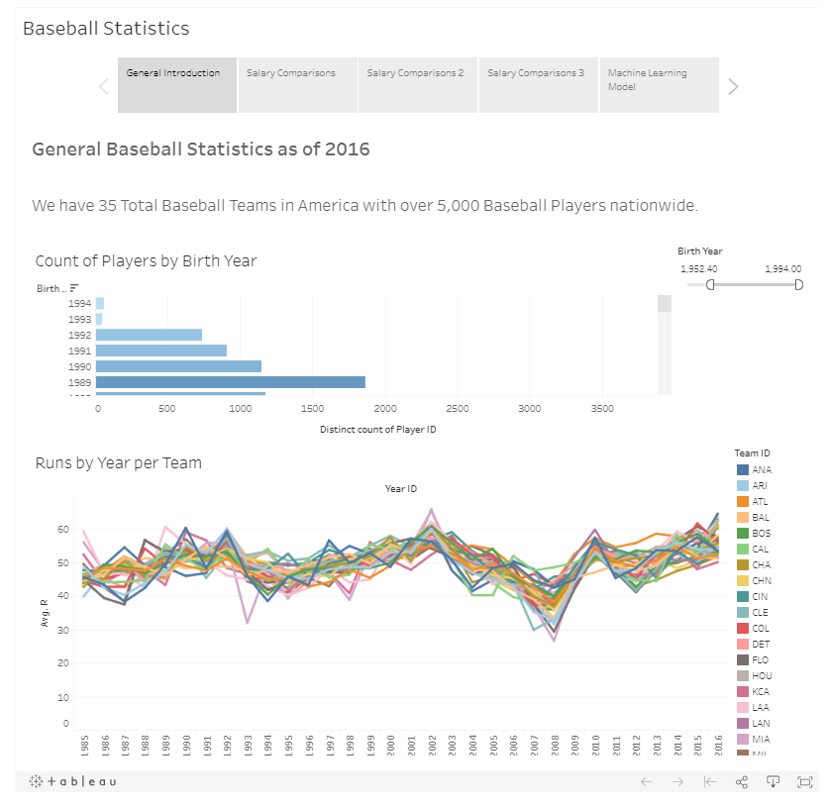
Dashboard
Our Tableau Story
Four-Time American League MVP Mike Trout
Frank
Notes:
Along with having individual dashboards, we also combined them all into a Story for ease of viewing.
And this is how I will do the live demonstration of the story.
Click image url or pull up Tableau Story –
On Tableau Story
General Introduction
Our first slide gives a brief showcase of what we can expect from our data.
We have the total amount of Baseball teams and players we are working with
We have a filter that allows anyone to specify what year range to look for the count of players
And a wonderful color stream showcasing a baseball statistic such as runs which is baseball’s version of points filterable by teams
Salary Comp
For our next 3 slides we wanted to zone in on how salaries play a part on various data
We have avg salaries by birth year, of a specific year, and of specific teams
Salary Comp 2
Next, our scatter plots to showcase salary relationships between specific baseball performance metrics
The Game played by Salary tends to shift directions depending on what years are being filtered
Team Runs per Hits by Year helps look at specific team metrics based on specific years, with the size of the dots being the avg runs while the distance measures avg hits
And our Runs per Hits by Salary tying it together with salary and seeing how certain players are still paid higher despite having lower avg hits and avg runs
Salary Comp 3
Our last salary slide looks at the correlation of salary and 3 additional baseball metrics: Homeruns, Runs Batted In (RBIs) and Strikeouts
All filterable by years
Machine Learning Model
Our Key Machine Learning Model results is fully presented here with our Confusion Matrix, Accuracy Score and Classification Report
And our List of Importances from Random Forest gave us a neat visualization of what we should focus on if we are deciding a player’s salary.
Our pie chart is filterable by specific feature but also which category they fall under Baseball Stats or Metrics or Other Statistics like birth year or Year played

Slide 17
The Debrief
Additional Analysis Options
Use a neural network approach to Machine Learning and attempt to predict which team will win the World Series.
Use current baseball statistics 2016 to present to see if the accuracy of our models holds up.
Next Time…
Focus on the rubric as opposed to the Role Guides in the Module.
Have a more structured approach to determining the questions we wanted to ask.
Keep a running list of dependencies for our ‘Requirements.txt’ file
David

Slide 18
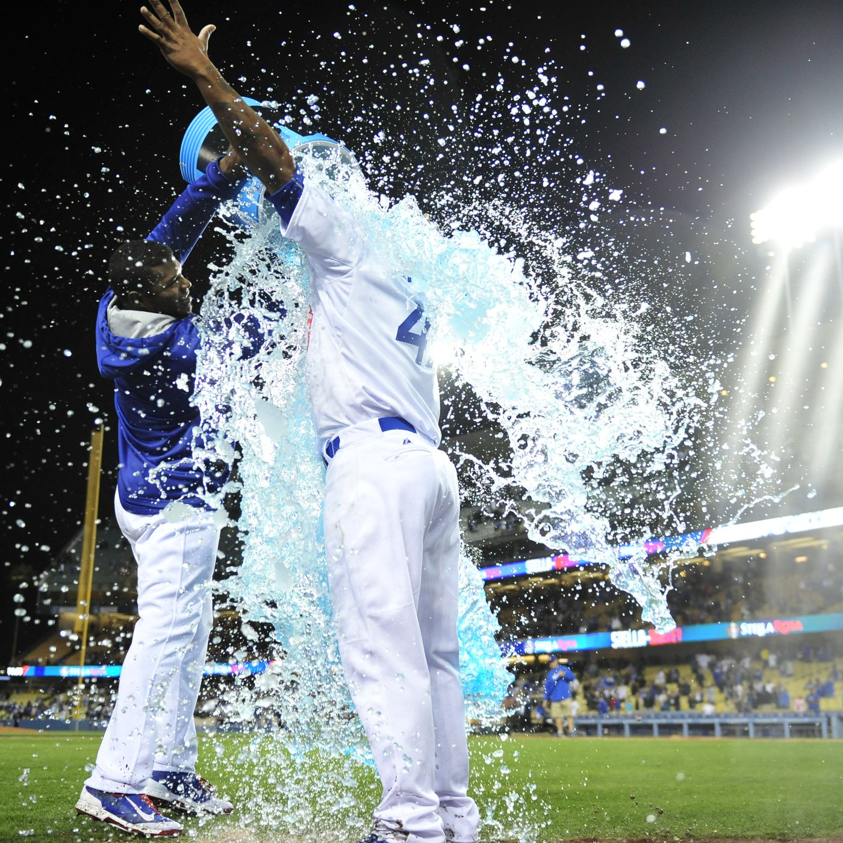
THANK
YOU!

